Slide 1

Credit Card Fraud Detection
Documentation

Slide 2

Table Of Content
Slide 3 Overview
Slide 4 Class Distribution
Slide 5 Distribution of Transaction Amount
Slide 6 Correlation Matrix
Slide 7 Model Building & Evaluation Using Logistics Regression
Slide 8 Model Building & Evaluation Using Decision Tree
Slide 9 Model Building & Evaluation Using Random Forest
Slide 10 ROC-AUC Report
Slide 11 ROC Curve
Slides 12&13 Observation & Conclusion

Slide 3

Overview
This presentation gives an insight into a credit card dataset and provides a valuable resource for developing and testing fraud detection algorithms, contributing to enhanced security and reduction of financial losses due to fraud.

Slide 4
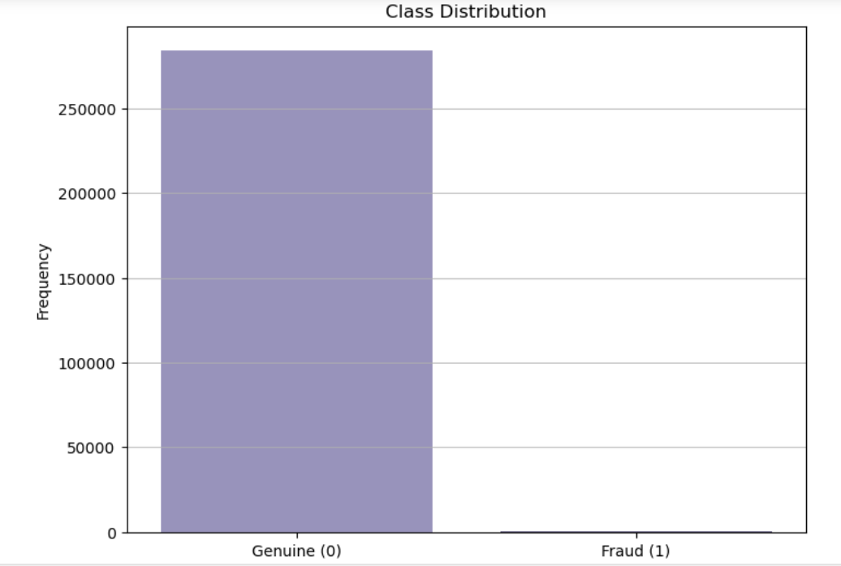
Class Distribution

Slide 5
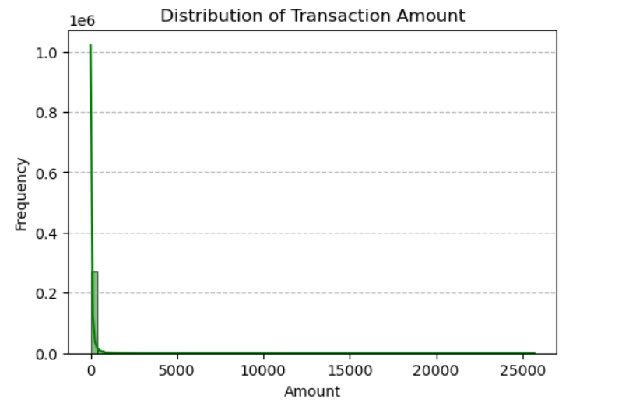
Distribution of Transaction Amount

Slide 6
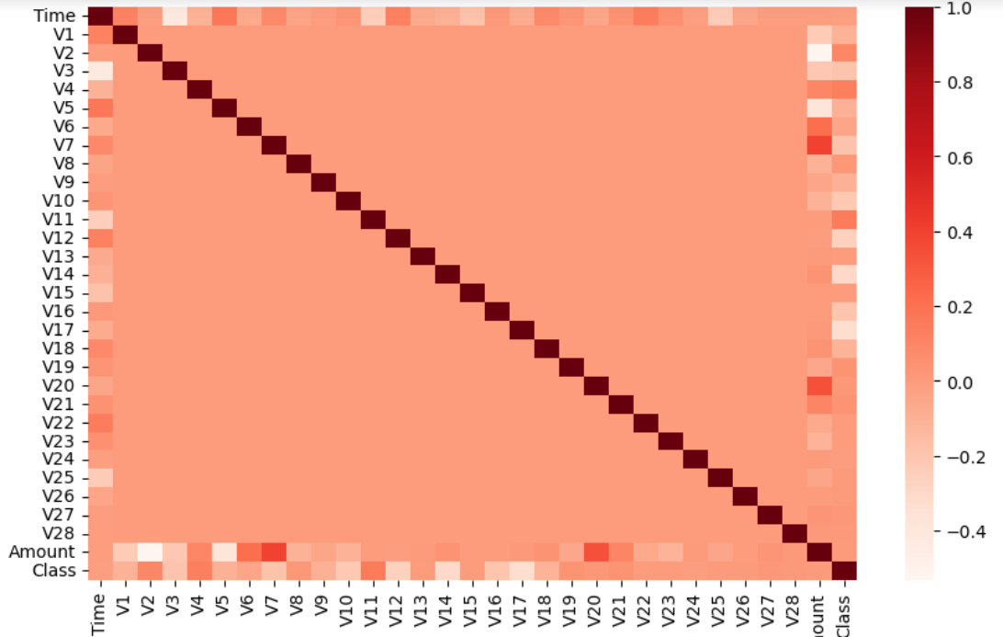
Correlation Matrix

Slide 7
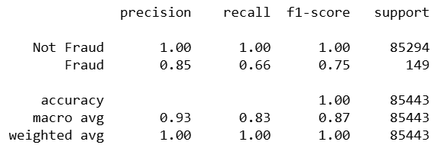
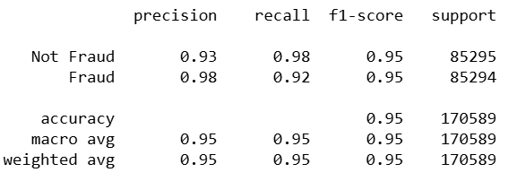
Model Building & Evaluation Using Logistics Regression
Before Resampling
After Resampling

Slide 8
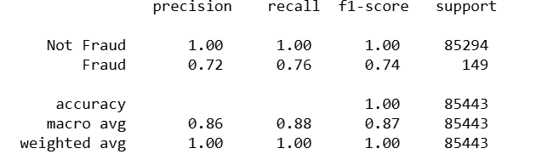
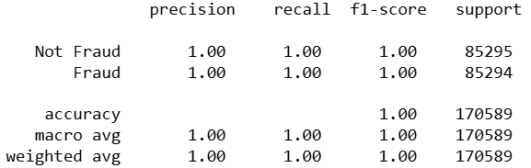
Model Building & Evaluation Using Decision Tree
Before Resampling
After Resampling

Slide 9
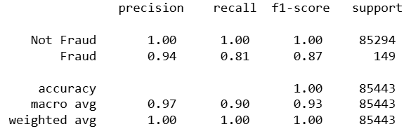
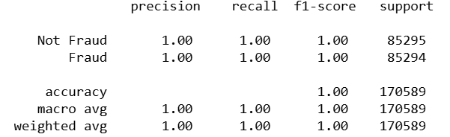
Model Building & Evaluation Using Random Forest
Before Resampling
After Resampling

Slide 10
ROC-AUC Report
ROC-AUC
ROC-AUC-Balanced
Logistics Regression - 0.9936166308620967
Decision Tree - 0.999917930921284
Random Forest- 1.0
Logistics Regression- 0.9873711821540251
Decision Tree - 0.9997244856087696
Random Forest- 1.0

Slide 11
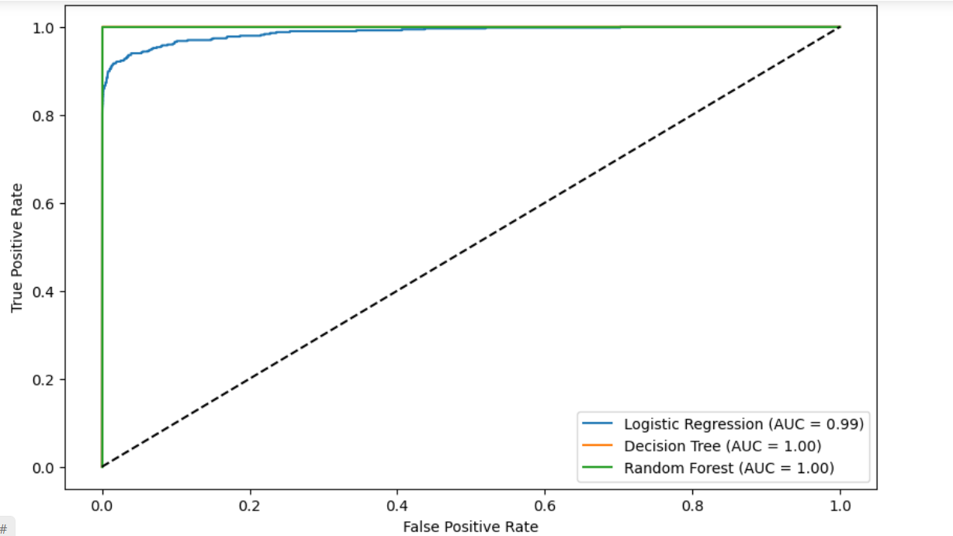
ROC Curve

Slide 12
Observation & Conclusion
There is a significant class imbalance with a much higher number of non-fraudulent transactions compared to fraudulent ones. The majority of transactions are of smaller amounts, with a few large transactions. The features V1 to V28 show different degrees of correlation with each other and the target variable Class.
Using StandardScaler, I performed a Feature Scaling on the ‘Time’ and ‘Amount’ columns to bring them in range of the Principal Component Analysis.
During the Model Building I split the data into training and test sets, then used three machine learning algorithms(Logistics Regression, Decision Tree and Random Forest) to build models. I evaluated these models based on accuracy, precision, recall, F1-score, and AUC-ROC.
During the Model Evaluation, I observed that all the models had an accuracy of nearly 100% because they were correctly predicting the majority class (non-fraud). However, they did not predict the fraudulent transactions with the same accuracy, as indicated by the precision and recall results.

Slide 13
Observation & Conclusion Continued..
To effectively detect the fraudulent transactions, I applied the Resampling technique to manually Oversample the Minority Class to get a more balanced dataset for retraining and evaluating the models. This approach led to excellent performance for all evaluated models, with perfect precision, recall, and F1-scores for both classes in the balanced test set.
Logistic Regression, Decision Tree, and Random Forest models all performed exceptionally well on the balanced dataset, achieving high accuracy and ROC-AUC scores. This indicates that the models can accurately distinguish between fraudulent and non-fraudulent transactions when trained on a balanced dataset.
Given the excellent performance of Logistic Regression, Decision Tree, and Random Forest models on the balanced dataset, any of these models can be considered for deployment.

